Slide 1
Google
Play
App
Predict the rating on Google Play Store Apps for the Android market with machine learning
Xiongfeng Wang, Brown DSI, 10/16/2020
https://github.com/XiongfengWang/1030project
Notes:
Hi everyone, I’m Xiongfeng Wang. Welcome to my midterm project presentation. My project is about predicting the Google Play Store Apps for Android market with machine learning.

Slide 2
Introduction
Predict the rating for Google Play Store Apps:
Rating affect App’s success and visibility.
Good prediction on new Apps is beneficial.
Regression: rating scales from 1 to 5 with decile level between each integer.
Dataset: Kaggle https://www.kaggle.com/lava18/google-play-store-apps
Notes:
This project will use machine learning to predict the rating for Apps in Google Play Store. This is a quite interesting problem to solve because rating is an important indicator for user experience, and will affect the App’s success and visibility. With the model we get we may be able to predict the rating so we can have a good expectation for new Apps and some clue for optimizing the existing Apps.
This is a regression problem because the target variable, rating, scales from 1 to 5 with decile level between each integer.
The dataset is downloaded from Kaggle.

Slide 3

Dataset OverView
10,358 samples, 13 columns
Drop duplicate samples
Drop samples missing rating
Drop ‘almost duplicate’
8,211 samples, 10 features (exclude App, Current Version, Ratings)
missing values
Group structure
Imbalance

Slide 4
EDA
Features | Reviews | Numerical | ‘Varies with device’ kB, MB to Byte
 | Price | Numerical | Remove $ sign
 | Last Updated | Numerical | Transfer to Days
Notes:
Heading to EDA. Here’s a table with classification and note for each variable. Please notice that all the classification refers to variable after necessary modification. For the highlighted variables, I’ll talk about them in detail soon.

Slide 5
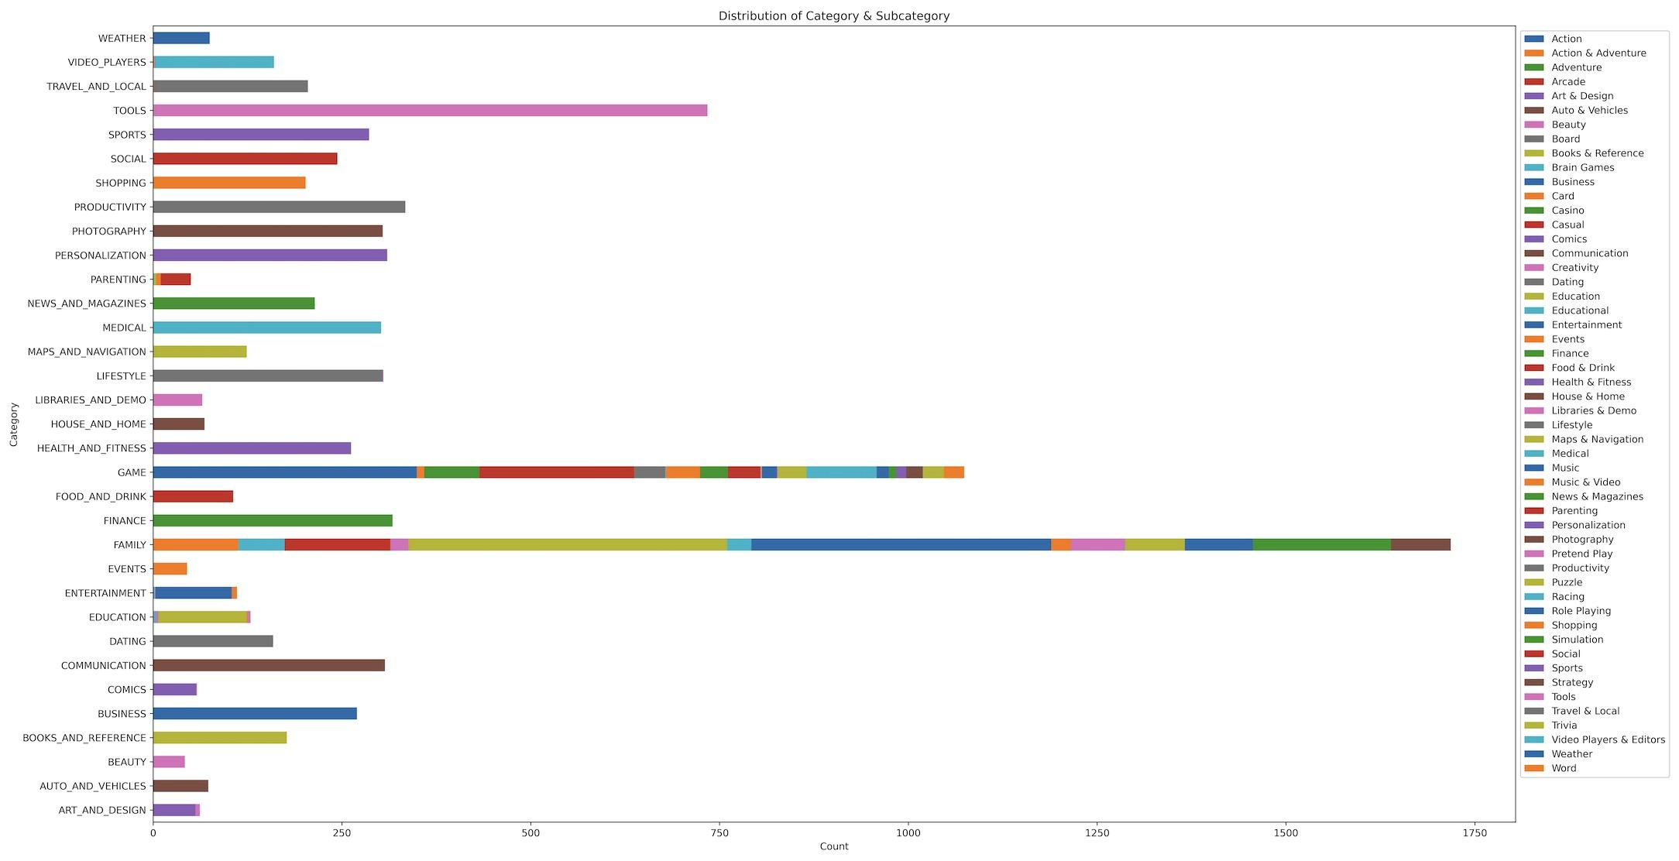
Group Structure: Category and Genres
Notes:
To plot this figure I grouped category and subcategory, fill the missing subcategory with main category. Family & Games are newly added samples, subcategory varies a lot.

Slide 6
Preprocessing
Group Structure: not I.I.D.
Not time series
Imbalance
GroupShuffleSplit

Slide 7
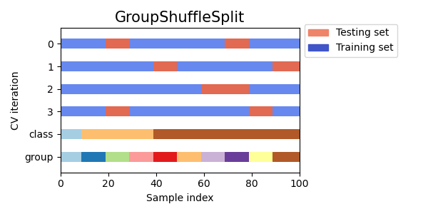
How to split
80%
Train
10%
Validation
10%
Test
Notes:
If I go with category, the 10% of the dataset will be used as test set which is around 900 samples. I think it is pretty good because the group shown in train should not be in test, 900 samples allows pretty much different group distribution.

Slide 8
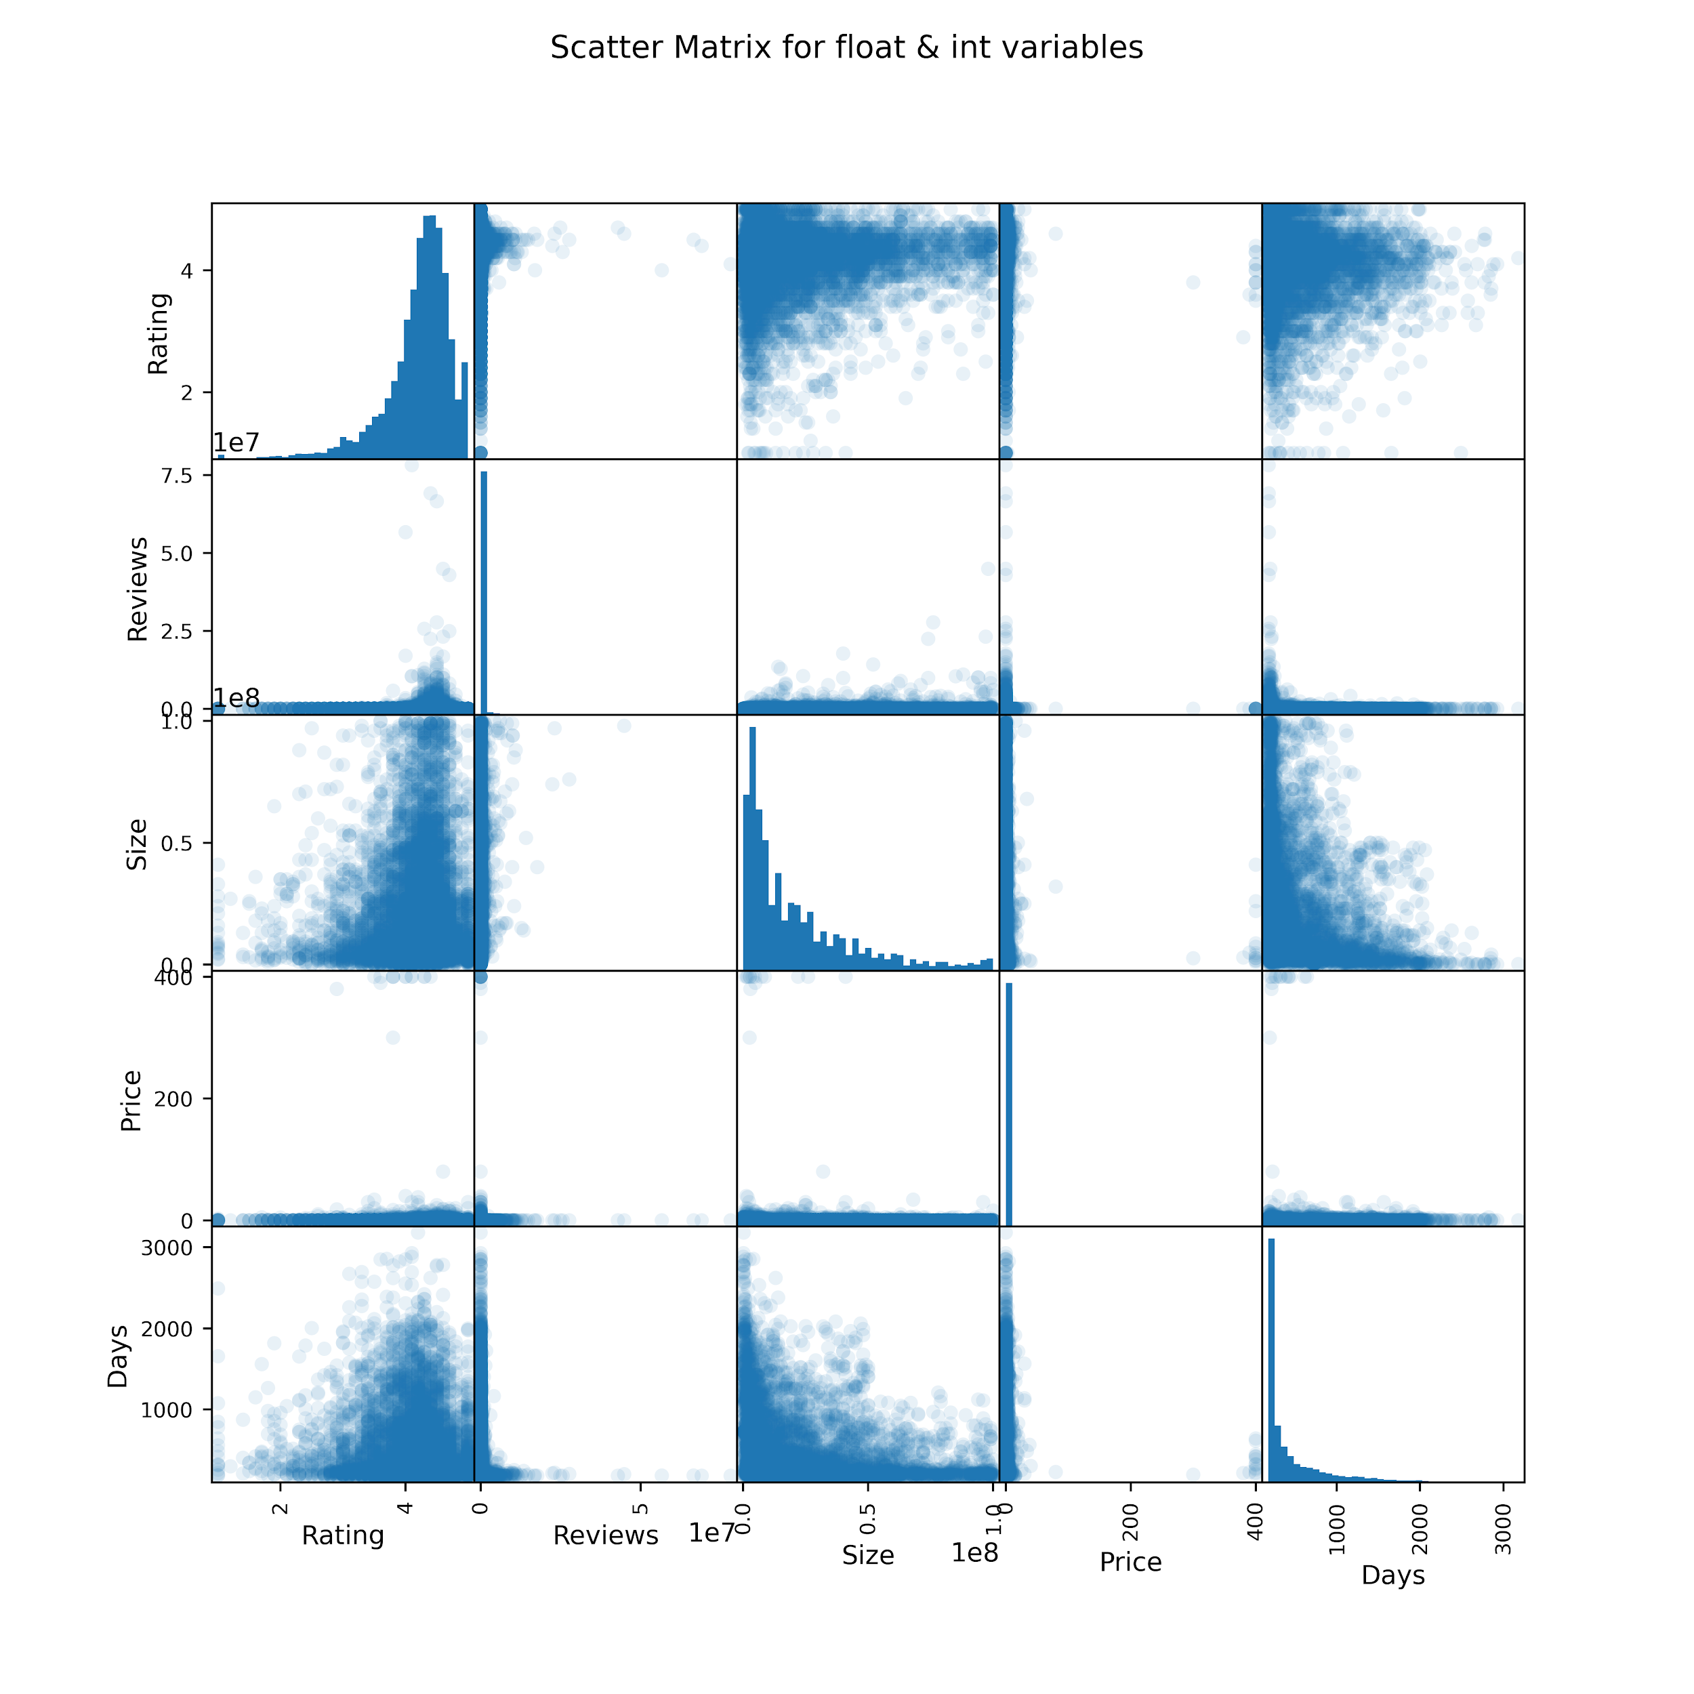
Missing Data
4 in Android Ver:
Assign ‘None’
1171 in Size (MAR):
Iterative imputation

Slide 9
Encoding
 | Variable | Classification | Encoder
Key | App
Features | Category | Categorical | OneHotEncoder
 | Reviews | Numerical | StandardScaler
 | Size | Numerical | StandardScaler
 | Installs | Categorical | OrdinalEncoder
 | Type | Categorical | OneHotEncoder
 | Price | Numerical | StandardScaler
 | Content Rating | Categorical | OneHotEncoder
Notes:
Most numerical variables are heavily skewed.

Slide 10
 | Variable | Classification | Encoder
Features | Genres | Categorical | OneHotEncoder
 | Last Updated | Numerical
 | Current Ver | Categorical
 | Android Ver | Categorical | OneHotEncoder
 | Subcategory | Categorical
 | Days | Numerical | StandardScaler
Target | Rating | Numerical
Notes:
9 features 8893 samples

Slide 11
Cross Validate
Model | Hyperparameter(s) | Values to try
Lasso | alpha | [1e-6, 1e-5, 1e-4, 1e-3, 1e-2, 1e-1]
Ridge | alpha | [1e-6, 1e-5, 1e-4, 1e-3, 1e-2, 1e-1]
Elastic Net | alpha | [1e-10, 1e-5, 1e-3, 1e-1]
 | l1_ratio | [0.1, 0.3, 0.5]
Random Forest | max_features | [1, 5, 10, 30, 50, 100]
 | max_depth | [0.1, 0.2, 0.3, 0.4, 0.5, 0.6]
SVM | gamma | np.logspace(-5, 5, 11)
 | C | np.logspace(-5, 5, 11)
KNeighbor | n_neighbors | np.linspace(10, 200, 20)
 | weights | ['uniform', 'distance']

Slide 12
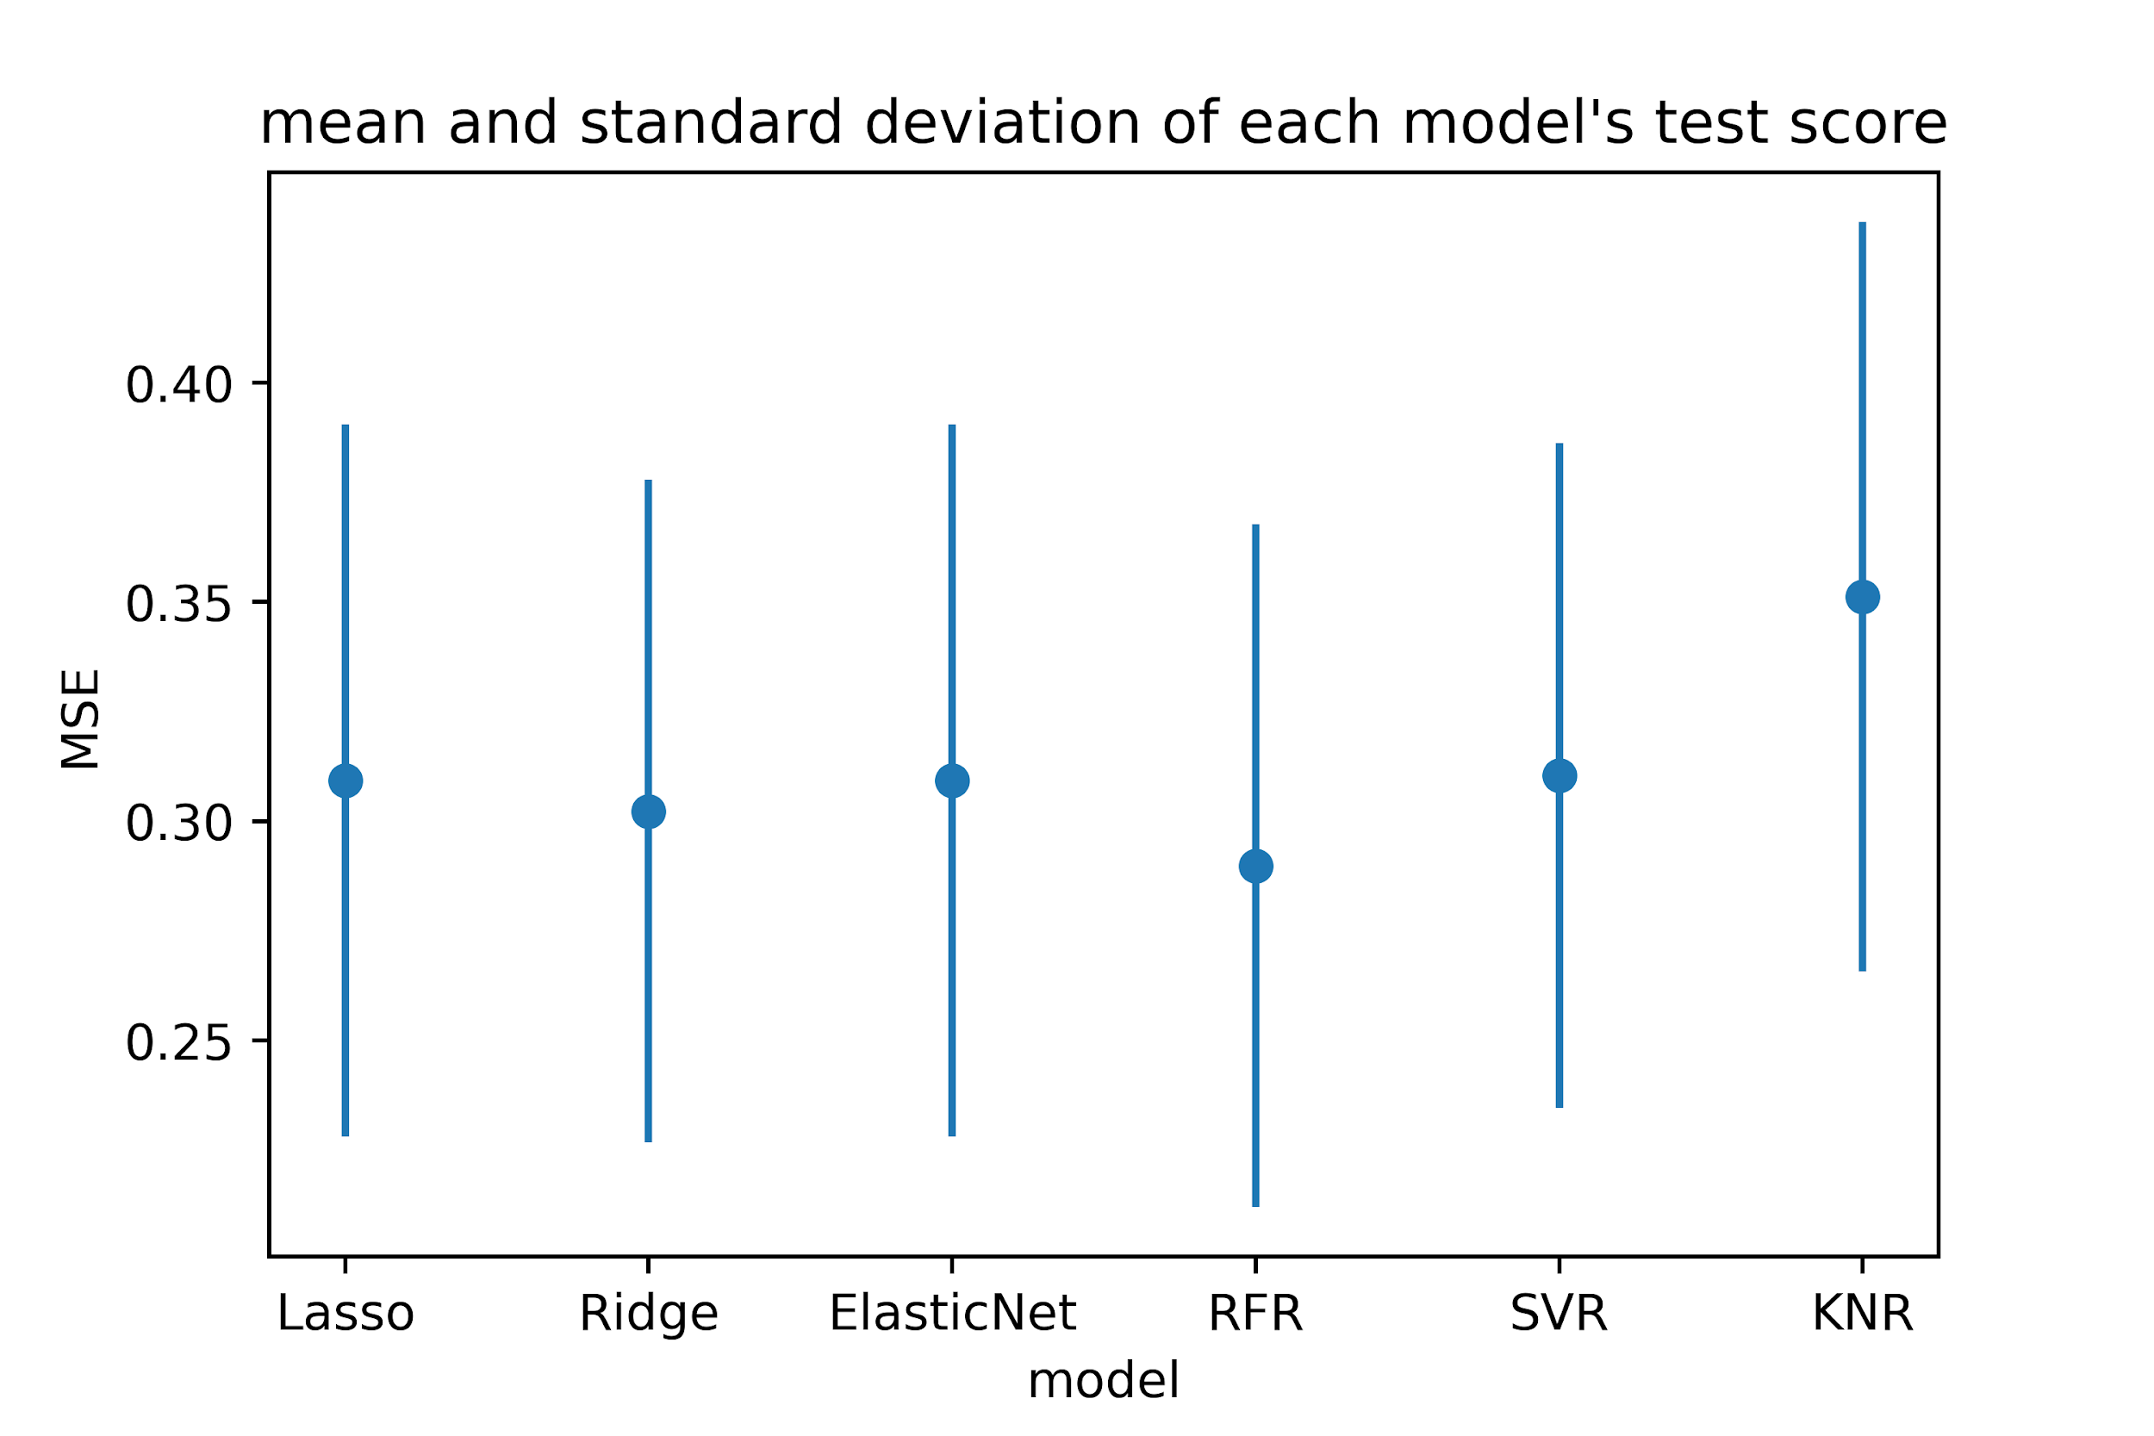
Returns
Baseline model: linear regression MSE = 2.65686 RMSE = 1.63

Slide 13
Returns
Random Forest Regression gives the best model with diverse hyperparameters.
np.mean(test_scores) = 0.28, rooted = 0.53
[RandomForestRegressor(max_depth=50, max_features=0.2), RandomForestRegressor(max_depth=10, max_features=0.6), RandomForestRegressor(max_depth=50, max_features=0.5), RandomForestRegressor(max_depth=10, max_features=0.6), RandomForestRegressor(max_depth=10, max_features=0.6), RandomForestRegressor(max_depth=50, max_features=0.2), RandomForestRegressor(max_depth=10, max_features=0.5), RandomForestRegressor(max_depth=30, max_features=0.3), RandomForestRegressor(max_depth=30, max_features=0.2), RandomForestRegressor(max_depth=10, max_features=0.5)]

Slide 14
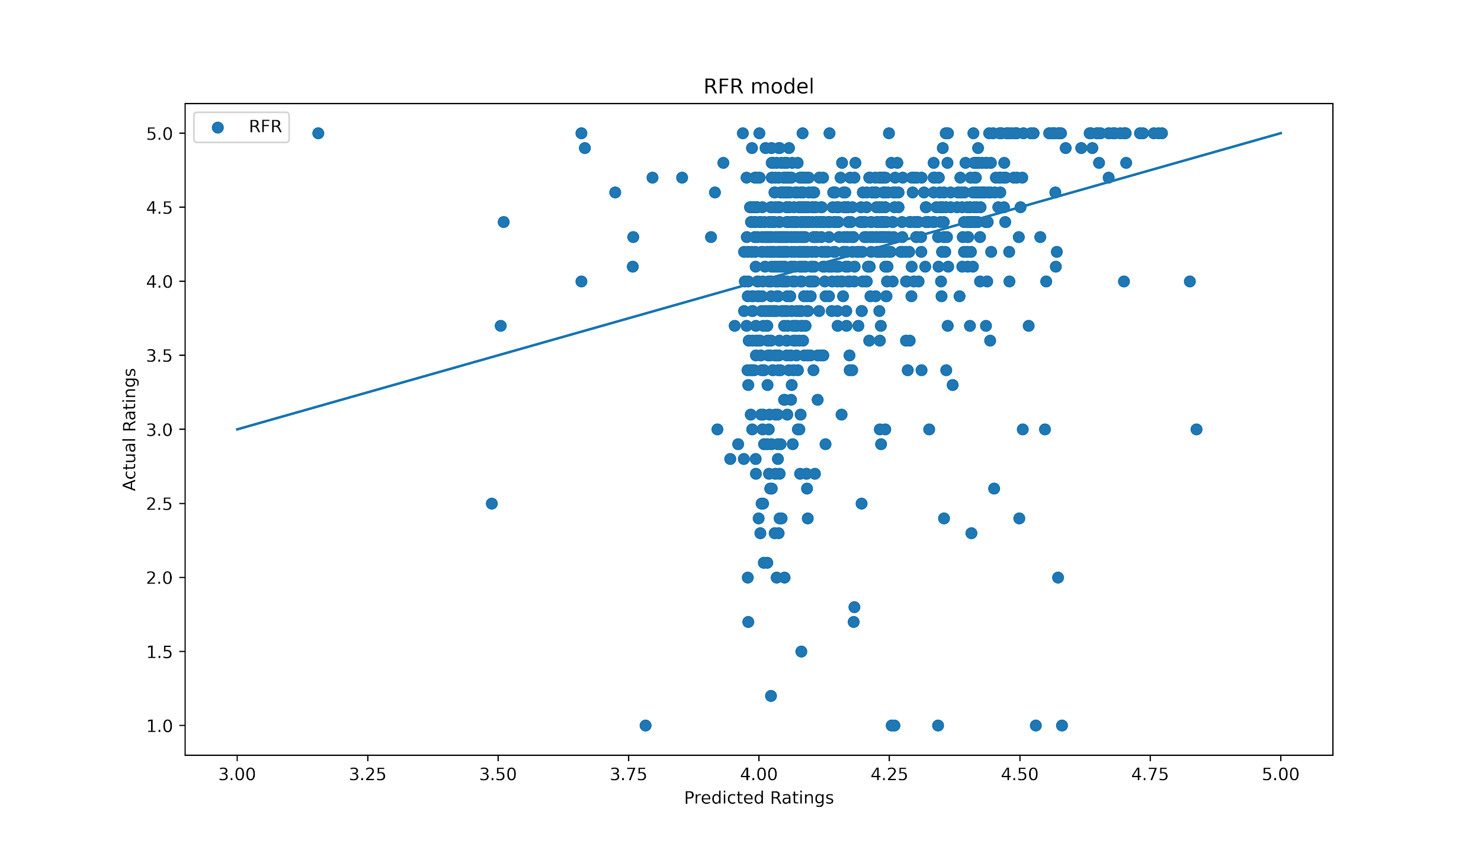
Returns

Slide 15
Outlooks
Remove samples with missing value (14%) instead of imputation
Try XGBoost
One App may have several samples with different name (‘Basket Manager 2016 Free)’, we can even the weight for these samples.
Try different Group Structure

Slide 16
Q&A

Slide 17
Thanks!
Please keep this slide for attribution.

